Slide 1

GSERM’21 Summer School
10,831,1.00 Deep Learning: Fundamentals and Applications
Lab 03: (Supervised) Machine Learning
Summer School 2021 - Prof. Dr. Damian Borth and Marco Schreyer

Slide 2


Rutgers Business School - Swiss Federal Audit Office Artificial Intelligence Agentic Auditing
63rd World Continuous Auditing & Reporting Symposium

Slide 3
Coding Lab Syllabus
Event Type | Date | Topic Area | Description
Lab 0-1 | < June 21st, 2021 | Introduction | Introduction to the Lab Environment - Jupyter Notebooks, Python Programming
Lab 2 | < June 21st, 2021 | Python Programming | Introduction to Python Programming - Python Decision Structures and Functions
GSERM’21 Summer School Start |  | Summer School Start
Lab 3 | June 21st, 2021 | Machine Learning | Supervised Machine Learning - Naive-Bayes, Support Vector Machines
Lab 4 | June 22nd, 2021 | Deep Learning I | Artificial Neural Networks (ANNs) - Backpropagation, MNIST Dataset
Lab 5 | June 23rd, 2021 | Deep Learning II | Deep Artificial Neural Networks (CNNs) - End-to-End Learning, CIFAR Dataset
Lab 6 | June 23rd, 2021 | Deep Learning III | Autoencoder Neural Networks (AENs) - Anomaly Detection, Financial Payments
Lab 7 | June 24th, 2021 | Deep Learning IV | Recurrent Neural Networks (RNNs) - Long-Short Term Memory, Sentiment Analysis
Lab 8 | June 25th, 2021 | Deep Learning V | Attention Neural Networks - Attention Mechanism, Text Summarization

Slide 4


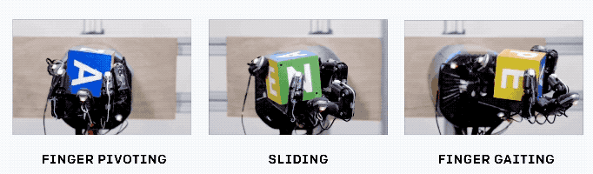
Lab Objectives
Thorough, Supplementary and Detailed
Learn and understand how to write and debug Python code.
Design, train and evaluate your own machine learning models.
Practical and State of the Art
Demystify the theoretical concepts of the lecture.
Look at state of the art software tools, e.g., Jupyter notebooks.
Research and Fun
Some materials cover new research of the past 1-3 years.
Coding is fun … this is a hands-on lab setup.
Source: “Unpaired Image-to-Image Translation using Cycle-Consistent Adversarial Networks”, Zhu J.Y., Park T., Isola P., Efros A., 2017
Source: “Learning Dexterous In-Hand Manipulation”, OpenAI, 2018

Slide 5
How to Contact Us
Course Website on Canvas: https://learning.unisg.ch/courses/9425
For all course materials, slides, notebooks, etc.
Course Discussion Forum (HSG students only):
Use this for most communication with course staff.
Ask questions about the assignments, grading, logistics, etc.
Communicate with your fellow students.
E-Mail: aiml-teaching.ics@unisg.ch
Use this to schedule meetings with course staff.
Use this in case of private matters.

Slide 6
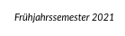
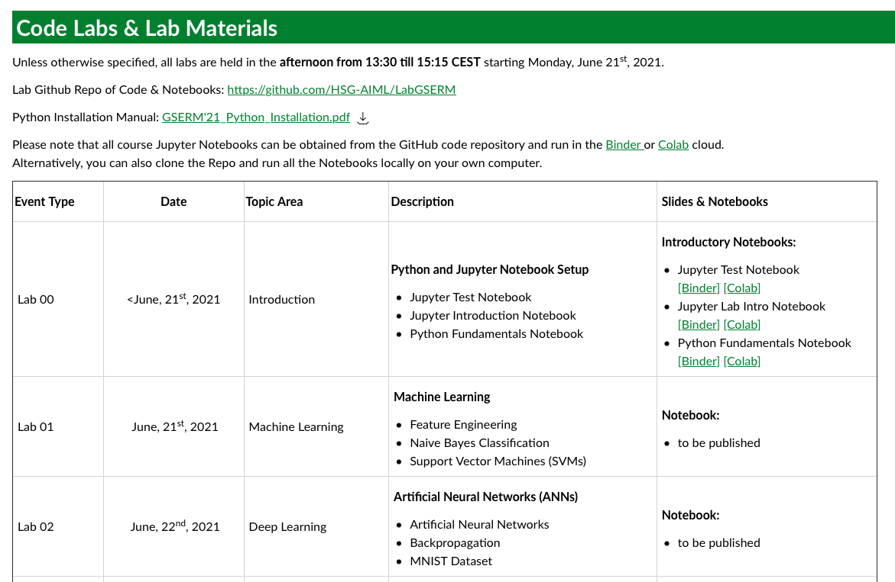
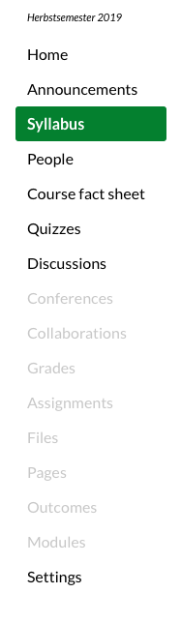
Lab Materials (Notebooks, Slides, and Datasets)
Labs will be published as the course progresses.

Slide 7
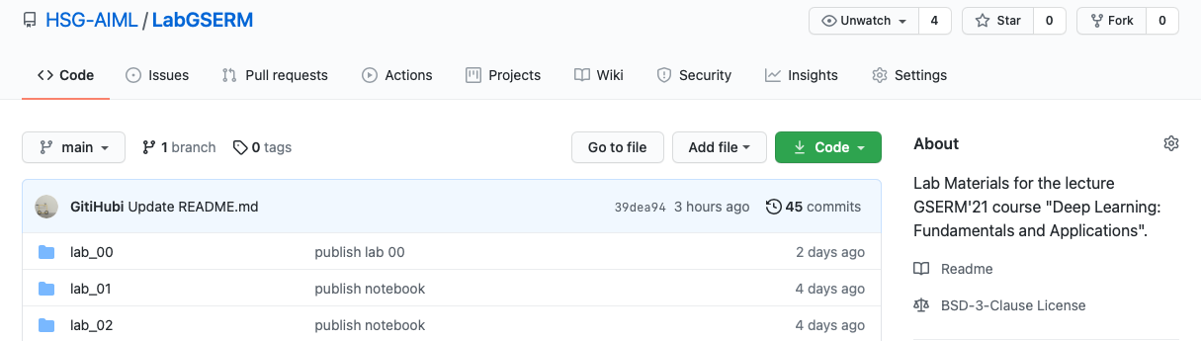
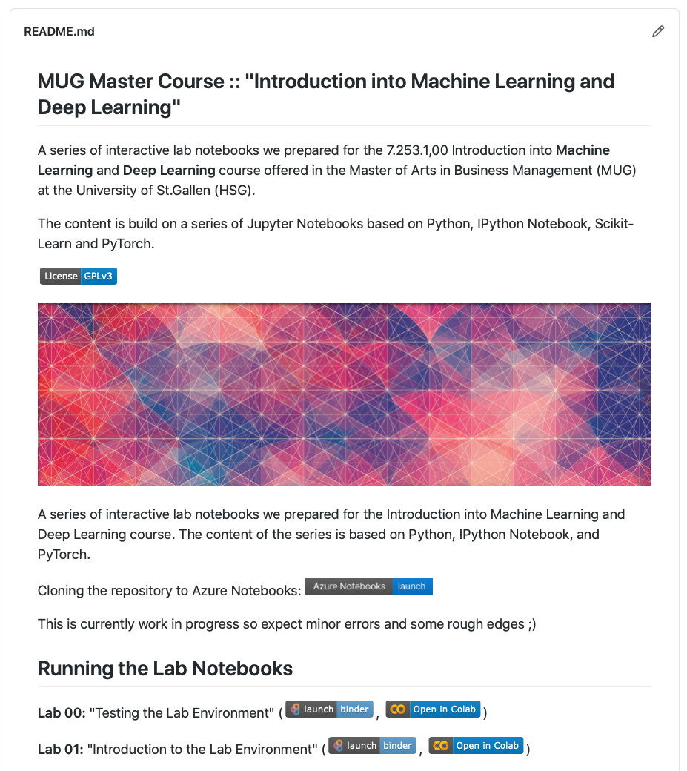
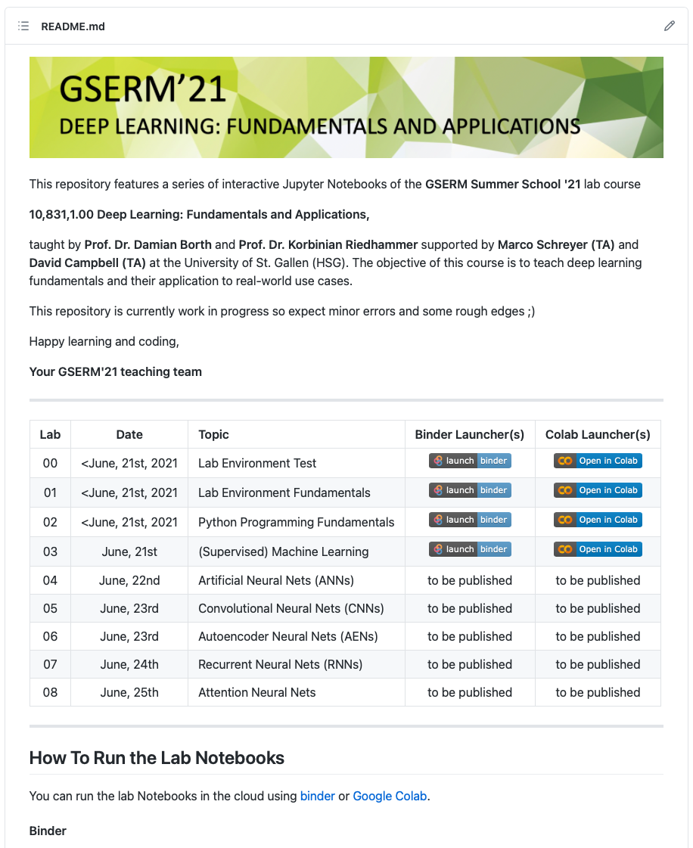
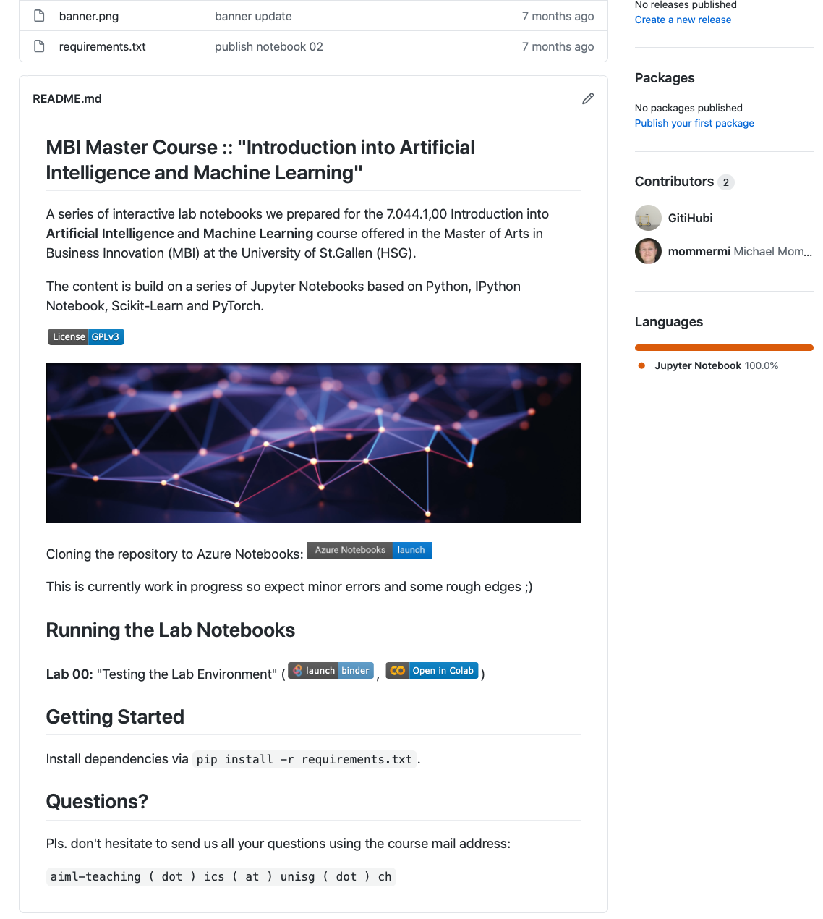
Course Code Repository
Repository URL: https://github.com/HSG-AIML/LabGSERM
“GoTo” page for all course code examples!
New lab notebooks will be published on a daily basis as the lecture of the course evolve.
Don’t hesitate to follow, star, open code issues, or submit a pull requests ☺
Notes:
MLD

Slide 8
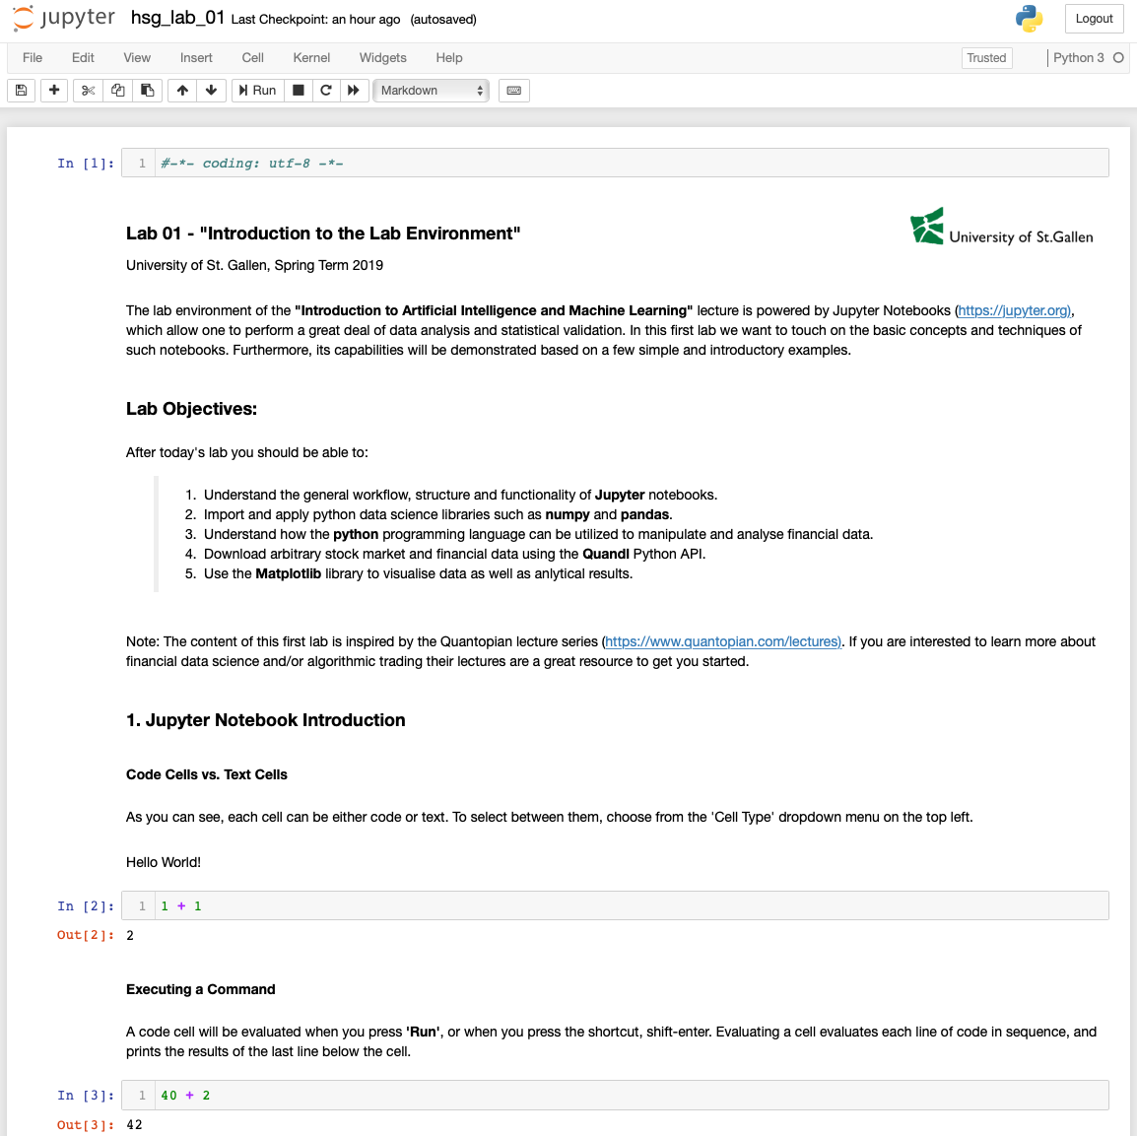


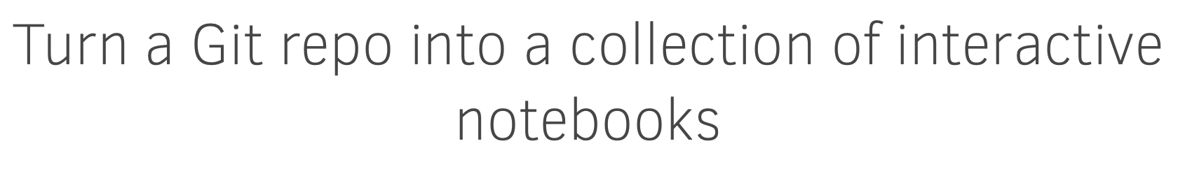
Notebook Coding Environment Options
NEW!
(1) Local Notebooks
(2) Colab Notebooks
(3) Binder Notebooks
y
y
https://localhost:8080
https://colab.research.google.com
https://mybinder.org
Prerequisites:
Python installation
Jupyter installation
Prerequisites:
Google Account
Prerequisites:
None

Slide 9
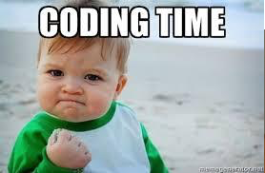
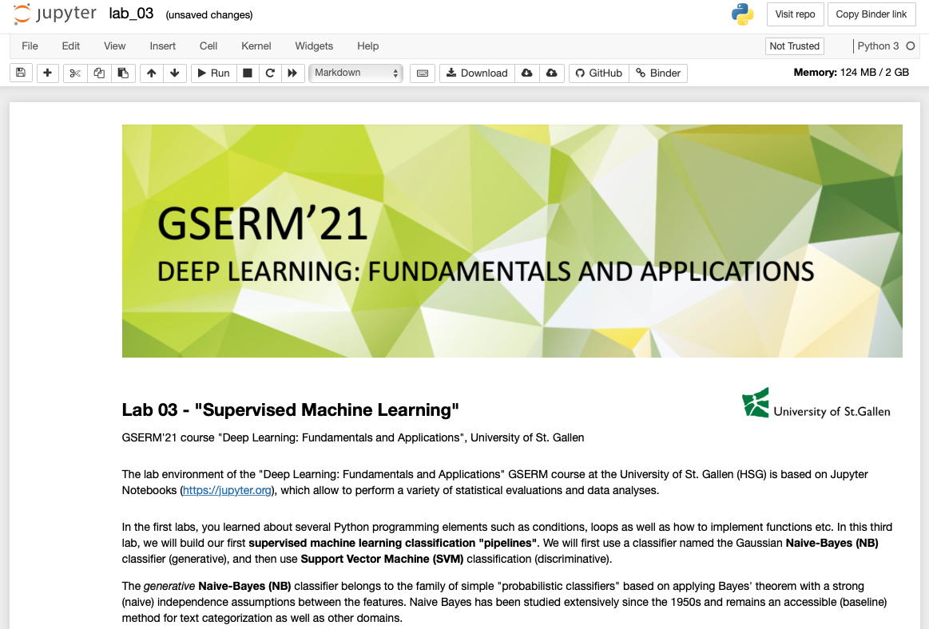
Let’s jump into the lab notebook…
https://github.com/HSG-AIML/LabGSERM/blob/main/lab_03/lab_03.ipynb

Slide 10
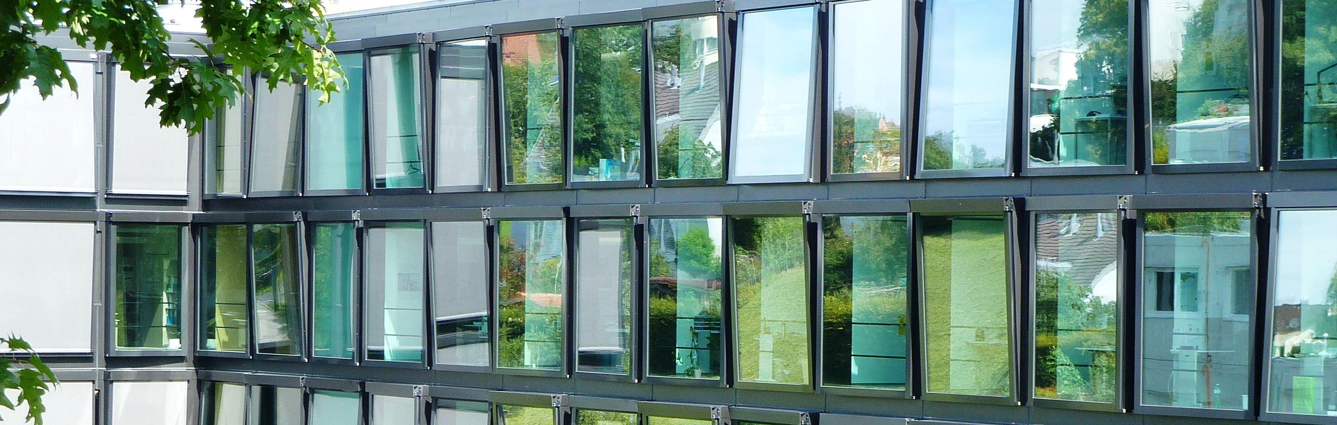

GSERM’21 Summer School
Deep Learning: Fundamentals and Applications
Happy Coding!

